Slide 1

Navigating NIH Peer Review to Get a Fellowship Grant
Dr. Vonda Smith
Scientific Review Officer
November 2, 2016

Slide 2
Top 8 Ways to Successfully Navigate NIH Peer Review
Know What a Fellowship Application Can Do for You
Know the Path of a Successful Application
Avoid 9 Common Applicant Pitfalls
Help Direct Your Application to the Best Place for Review and Funding
Understand Who Your Reviewers Are
Know What Reviewers Are Looking for
Consider Advice From NIH Staff
Ask the Right NIH Person for Help

Slide 3
1. Know What a Training or Fellowship Application
Can Do for You
Ruth L. Kirschstein
National Research Service Awards (NRSA)
Fellowships (Fs) Supports Research Training:
For doctoral students and new postdoctoral researchers
In basic and/or clinical research
In any scientific area within the NIH scientific mission
At domestic or foreign institutions
F-Kiosk: https://researchtraining.nih.gov/programs/fellowships

Slide 4
NRSA Predoctoral Awards
F30: Supports up to 6 years of combined MD/PhD training.
F31: Supports up to 5 years of PhD (or equivalent) training during dissertation research.
Diversity F31: Supports underrepresented, disadvantaged individuals and those with a disability.

Slide 5
NRSA Postdoctoral Fellowships
F32: Support up to 3 years of postdoctoral research training.
Awardees incur one year of payback.
Repay the 1st year by staying in research a 2nd year

Slide 6
NRSA Benefits and Stipends
2016 NRSA Benefits
2016 NRSA Stipend
Tuition/Fees
Predoc: 60% of requested tuition, capped at $16,000 ($21,000 for MD/PHD programs)
Postdoc: 60% of requested tuition, capped at $4,500 ($16,000 if seeking another doctoral degree)
Training Related Expenses
Predoc: $4,200
Postdoc: $8,850
Includes Health Insurance
Predoc: $23,376
Postdoc by Years of Experience
0 = $43,692
1 = $45,444
2 = $47,268
3 = $49,152
4 = $51,120
5 = $53,160
6 = $55,296
7+ = $57,504

Slide 7
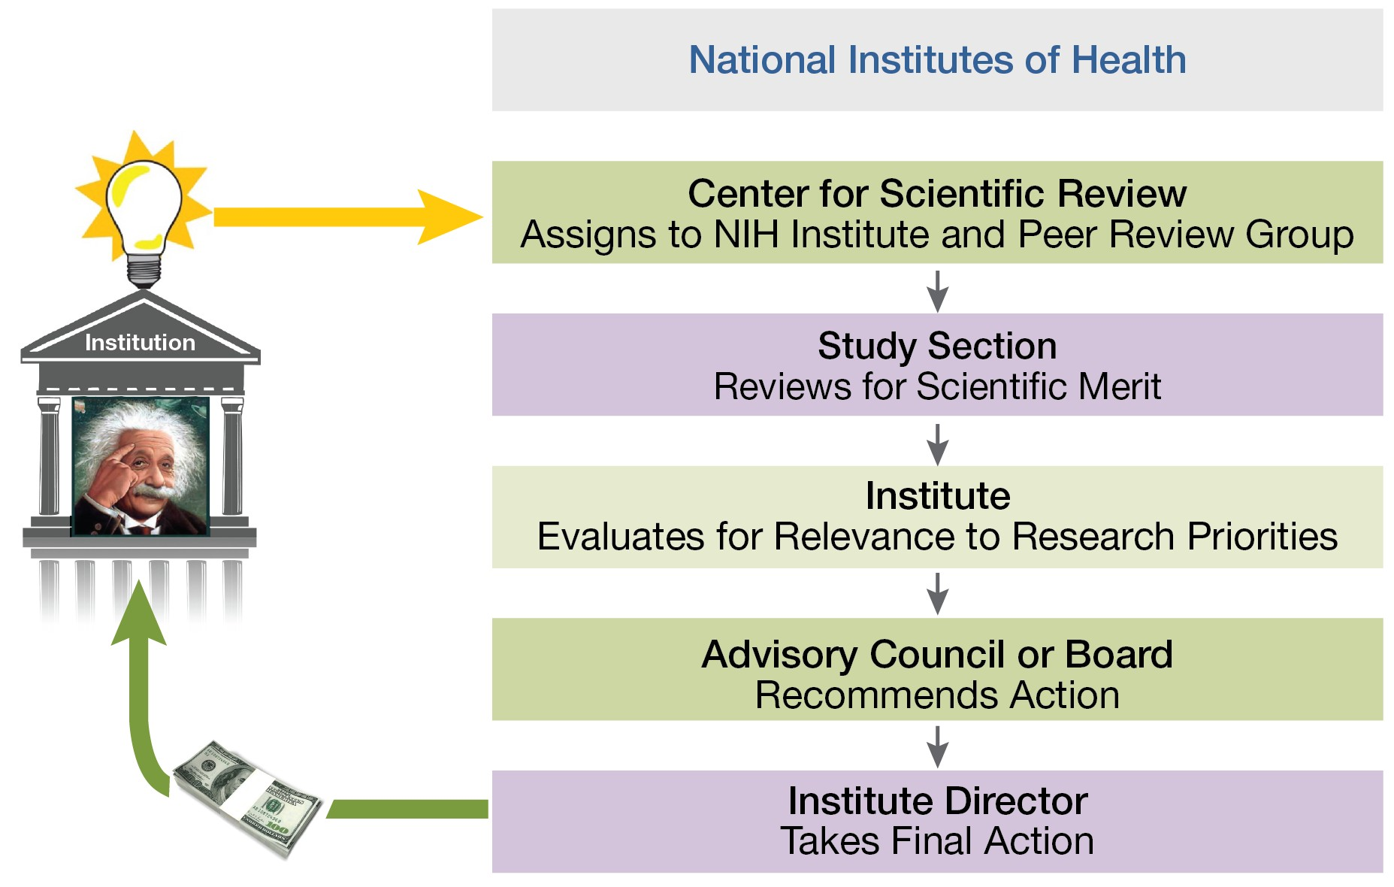
2. Know the Path a Successful Application

Slide 8
Avoid 9 Common Applicant Pitfalls
1. Missing Letters and Attachments
2. Failing to Appreciate Submission Is a Multi-Step Process
3. Submitting Your Application at the Last Minute
4. Not Using the Right Application Form
5. Not Giving the Instructions Enough Attention
6. Producing an Incomplete Application
7. Overstuffing Your Application
8. Submitting a New Application but Referring to Previous
Review Outcomes or Criticism
9. Using a Small Font

Slide 9
Missing Letters and Attachments
Missing Letters
One of your references may fail to submit their letter.
Counting a letter from your sponsor or a collaborator as a reference letter.
Letters from collaborators are also required to show their
commitment.
Missing Attachments
Diversity F31s require a letter from the institution saying the
applicant is qualified as a diversity applicant.

Slide 10
4. Help Direct Your Application to the Best
Place for Review and Funding

Slide 11
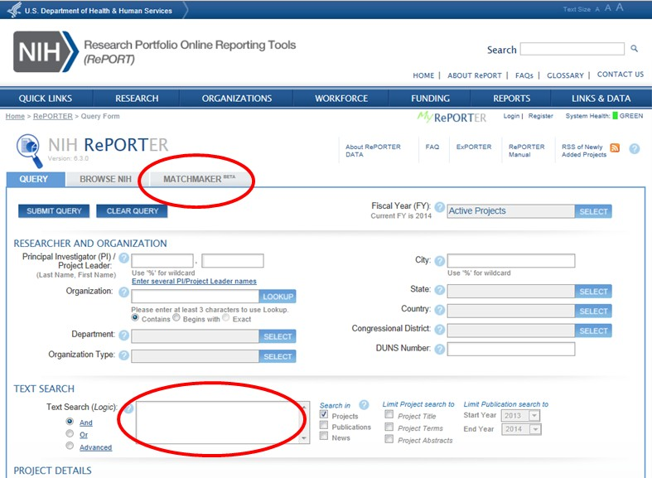
Find an NIH Institute or Center Who Might Fund
Your Research
NIH Reporter
http://projectreporter.nih.gov/reporter.cfm
Notes:
Search funded application abstracts to identify institutes/centers who might have an interest in your research.

Slide 12
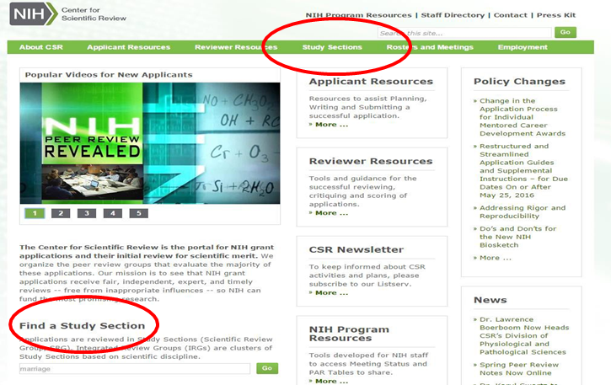
Find a Study Section to Review Your Application
http://www.csr.nih.gov

Slide 13
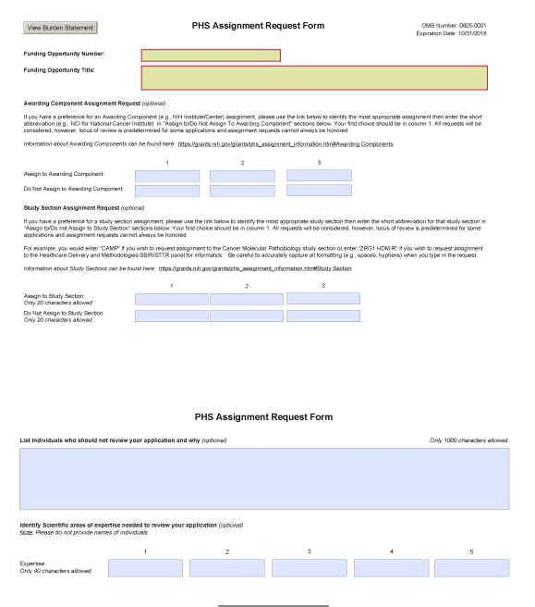
Tell CSR Your Assignment Preferences
Assignment Request Form
Request Institute assignment(s)
Requests review group assignment
Identify conflicts of interests
Suggest expertise
Never Request Specific Reviewers
Notes:
If an applicant has no clue then CSR staff will do their best to identify the appropriate study section. They are not required to identify a study section.

Slide 14
Have a Question During Today’s Webinar?
Send it to askexperts@csr.nih.gov
We will answer questions at the end of the program

Slide 15

5. Understand Who Your Reviewers Are
Reviewers are senior scientists with a broad range of scientific expertise and background
Notes:
Can be one or multiple slides…..

Slide 16
6. Know What Reviewers Are Looking for
Impact
Exciting ideas
Clarity of the research and training plans in context of your career goals
Realistic aims and timelines -- Don’t be overly ambitious
Brevity with things that everybody knows
Noted limitations of the study
A clean, well-written application
Notes:
Speaking generally . . .

Slide 17
Fellowship/Training Main Review Criteria
Overall Impact
Assessment of the likelihood that the proposed training will enhance the candidate’s potential for a productive, independent scientific career.
Five Core Review Criteria

Slide 18
Five Core Review Criteria
Fellowship Applicant
  Scholastic performance
  Productivity commensurate with career stage
  Aptitude and enthusiasm
  Clarity of stated career goals
  Letters of reference

Slide 19
Five Core Review Criteria
Sponsors, Collaborators, and Consultants
  Documented mentoring successes
  Expertise in the field
  Present productivity
  Funds available to cover research expenses
  Co-mentor to cover weaknesses
  Clearly defined roles for mentors and collaborators

Slide 20
Five Core Review Criteria
Research Training Plan
  Significance & impact of the proposed research
  Logical hypothesis or approach
  Clarity, feasibility and alternative strategies
  Stats, vertebrate animals, human subjects
  Sophisticated technologies and approaches
  Likelihood training will lead to publications and degree
  Appropriate for the applicant fellow's stage of research development

Slide 21
Five Core Review Criteria
Training Potential
  Is there individualized training that addresses weaknesses and career development needs?
  Will participants learn new technical skills, new design approaches?
  Do training activities match career goals?
  Will training confer an advantage to be competitive?
  Will the the applicant fellow receive requisite individualized and supervised experiences?

Slide 22
Five Core Review Criteria
Institutional Environment and Commitment to Training
  Scientific environment
  Opportunities for collaborations within and outside institution if needed
  Resources available

Slide 23
Training in the Responsible Conduct of Research
Reviewers are asked to state whether the proposed training is “Acceptable” or “Not Acceptable”
Is there formal and face-to-face training?
Are all ethical topics clearly depicted?
Are faculty participating in the training?
Will the total hours of training be at least 8 contact hours?
Are future opportunities/refreshers for continued training
listed?
Does retraining occur every 4 years or at every career stage?

Slide 24

7. Consider Advice from NIH Staff
Your sponsor needs to be an active/dynamic participant in your training.
Your grant should not just be a way of funding your sponsor’s research
Your efforts should show some uniqueness or individualized component to them
But your research should be related to your sponsor’s research.
Notes:
Bullet 1 – it’s important for your sponsor to write a customized career mentoring plan for you.

Slide 25
More Advice from NIH Staff
Don’t just say what you’ve done. Say how it fits into the bigger picture.
Emphasize how you’re going to fill gaps in your expertise, add to your tool set, and explore different approaches or different problems.
Be upfront about any flaws and how you’re going to address them.

Slide 26
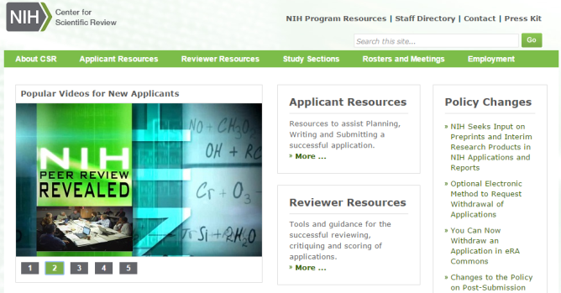
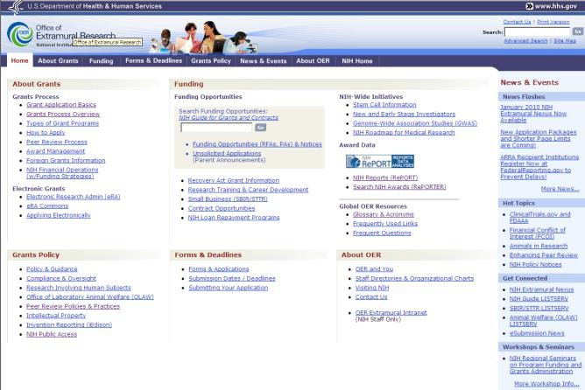
Key NIH Review and Grants Web Sites
NIH Center for Scientific Review
http://www.csr.nih.gov
NIH Office of Extramural Research
http://grants.nih.gov/

Slide 27
8. Ask the Right NIH Person for Help
Before You Submit Your Application
A Program Officer at an NIH Institute or Center
Scientific Review Officer
After You Submit
Your Scientific Review Officer
After Your Review
Your Assigned Program Officer
Notes:
Of course . . . The first person you want to seek help from is your sponsor at your institution.

Slide 28

We Want Your Applications!

