Slide 1
MS2 Transition to Graduate School
2025

Slide 2

Applying for Graduate School
Google survey for Mentor and Graduate Program match
  https://forms.gle/W9A59VDDfjtHR1DA6
  Due January 5, 2026
If a student is starting in a new rotation after clinical rotations, this paperwork is due by June 30.
  Instead, we will need the rotation paperwork filled out.
  This is included on the faculty agreement

Slide 3

Applying for Graduate School
Pitt Graduate School of Medicine
Graduate Program | Program Director | Program Director Email | Program Coordinator | Program Coordinator Email
Biomedical Informatics | Harry Hochhesier | harryh@pitt.edu | Toni Porterfield | tls18@pitt.edu
Cell Molecular and Systems Biology (CMSB)** | Michael Tsang | tsang@pitt.edu | Shari Murphy | cmsb.som@medschool.pitt.edu
Cellular & Molecular Pathology (CMP)+ | Andrew Duncan | duncana@pitt.edu | Amanda Bytzura | AMB430@pitt.edu
Clinical & Translational Sciences (CTSI) * | Galen Switzer | gswitzer@pitt.edu | Genny McCarthy | gcm19@pitt.edu
Computational Biology | James Faeder | faeder@pitt.edu | Kelly Gentile | kmg120@pitt.edu
Program in Microbiology and Immunology (PMI) | Zandrea Ambrose | zaa4@pitt.edu | Candice (Candy) Kuo | cak94@pitt.edu
Molecular Biophysics & Structural Biology (MBSB) | Andrew Hinck | ahinck@pitt.edu
Molecular Pharmacology + | Tija Jacob | tcj11@pitt.edu | Shannon Granahan | granahan@pitt.edu
Neurobiology (CNUP) | Robert Turner | rturner@pitt.edu | Patti Argenzio | argenzio@pitt.edu
Cancer Biology and Oncology Graduate Program | Chris Bakkenist and Carola Neumann | bakkenistcj@upmc.edu |  | oncologygradprogram@pitt.edu
**NOTE: CMSB is combined from CBMP, ISB and MGDB
*Please work with Kathy if entering CTSI, tuition funding is not automatically covered by the SOM
+Interdisciplinary Biomedical Graduate Program

Slide 4
Applying for Graduate School
Graduate School of Public Health
Graduate Program | Program Director | Program Director Email | Program Coordinator | Program Coordinator Email
Epidemiology | Iva Miljkovic | ivm1@pitt.edu | Lori Smith | smithl@pitt.edu
School of Arts & Sciences
Graduate Program | Program Director | Program Director Email | Program Coordinator | Program Coordinator Email
Neuroscience | Stephen D. Meriney | meriney@pitt.edu | Patti Argenzio | argenzio@pitt.edu
School of Engineering
Graduate Program | Program Director | Program Director Email | Program Coordinator | Program Coordinator Email
Bioengineering | Mark Redfern | mredfern@pitt.edu | James Robnett | jar425@pitt.edu

Slide 5
Applying for Graduate School
Carnegie Mellon University
Graduate Program | Program Director | Program Director Email | Program Coordinator | Program Coordinator Email
Biomedical Engineering | Charlie Ren | xir@andrew.cmu.edu | Maryia Rakach | mrakach@cmu.edu
Biological Sciences | Alison Barth | barth@cmu.edu | Ena Miceli | emiceli@andrew.cmu.edu
Neural Computation | Gelsey Torres-Oviedo | gelsyto@pitt.edu | Melissa Stupka | mstupka@andrew.cmu.edu
Psychology | Kasey Creswell | kasey@andrew.cmu.edu | Erin Donahoe | donahoe@andrew.cmu.edu
Social & Decision Sciences | Gretchen Chapman | gchapman@andrew.cmu.edu | Connie Angermeier | cla2@andrew.cmu.edu
Systems Neuroscience | Aryn Gittis | agittis@cmu.edu | Melissa Stupka | mstupka@andrew.cmu.edu
Computational Biology | Carl Kingsford | ckingsf@andrew.cmu.edu | Nicole Stenger | nstenger@cs.cmu.edu
Human Computer Interaction | Brad Myers | bam@cs.cmu.edu | Carolyn Buzzelli-Stumpf | cbstumpf@cs.cmu.edu

Slide 6
Applying for Graduate School cont.
Pitt SOM Graduate Programs – no application is required Only the transfer form, which is the MSTP Faculty Agreement is needed
  Last page of the faculty agreement. All signatures are needed, and the payroll administrator is especially important.
  See below.

Slide 7
Applying for Graduate School cont.
For CNUP (Neurobiology/Neuroscience)
  Early in Spring Term, the MSTP Office will send Patti Argenzio a list of the MSTP students that plan to join the CNUP Program in Fall (September 1)
  At that time, the program coordinator will send you our application and the lab selection form.
  Note that you are already accepted to the CNUP Program, the application is only used to obtain information needed to enter you in our student system.
  You will officially become a CNUP graduate student September 1.

Slide 8
Applying for Graduate School cont.
Pitt Public Health
  Epidemiology – Deadline January 15
    Application is due through SOPHAS (fee is required)
      https://sophas.org/
    The application is only a formality and the documents that you submitted for MSTP application you can use in SOPHAS
    MCAT can be used instead of GRE
    Reach out to Lori Smith (smithl@pitt.edu)

Slide 9
Applying for Graduate School cont.
Pitt BioEngineering
  Only the transfer form is needed, this is the last page of the faculty agreement. All signatures are needed, and the payroll administrator is especially important.

Slide 10
Applying for Graduate School cont.
CMU Graduate Programs
  Biomedical Engineering - December 1
  Biological Sciences - December 1
  Neural Computation - No application due
  Psychology - December 1
  Social & Decision Sciences – December 15
  Systems Neuroscience - No application due
  Computational Biology - No application due
  Human Computer Interaction – December 10

Slide 11
Transition Paperwork
For all graduate programs, Petition to Transfer Form (last page of the MSTP Faculty Agreement) is due Feb 1.
FOR GRADUATE SCHOOL ADVISORS
  PETITION TO TRANSFER FROM THE MSTP TO A PHD – GRANTING TRAINING PROGRAM
Upon successful completion of all MS1, MS2 and Step 1 requirements, I hereby request a change from the medical portion of the MSTP to the training program in:
_____________________________________________________________________________________
Name of Graduate Training Program
_____________________________________________________________________________________
Petitioning Student Signature Date Print Last Name
By signing I am attesting to the fact that I have met with my chosen graduate faculty director and discussed milestones and what is expected of a MSTP student in my
chosen graduate program.
I agree to serve as the Ph.D. advisor for the petitioning student and will provide them with financial support during their graduate studies.
_____________________________________________________________________________________
Advisor signature Date Print Last Name
_____________________________________________________________________________________
Name and contact information of advisor’s payroll administrator
The _________________________________________will provide financial support for the above-named
Name of Department, Clinical Division or Research Institute
student should funds become unavailable from her/his dissertation advisor.
_____________________________________________________________________________________
Signature of Dep. Chair, Division Chief, or Institute Director Date Printed Last Name
We wish to admit ______________________________________________to our training program.
Name of Petitioning Student
_____________________________________________________________________________________
Program Director Signature Date Printed Last Name
PITT-CMU MSTP Director signature:
The PITT-CMU MSTP agrees to accept financial responsibility for the trainee in his/her MD years as detailed in the attached stipend policy.
___________________________ ________________________________ _________
Name Signature Date

Slide 12
Transition Paperwork
If a student is starting in a new rotation after the clinical rotations, this paperwork is due by June 30.
  Instead, we will need the rotation paperwork filled out.
  This is included on the faculty agreement
FOR SUMMER ROTATION ADVISORS
I have read sections 1-VIII and agree to have the below student rotate in my laboratory. I understand the expectations of the MSTP should the student and I later mutually agree for the student to conduct their graduate training under my mentorship.
_____________________________________________________________________________________
Mentor Signature Date Print Name
_____________________________________________________________________________________
Student Signature Date Print Name
_____________________________________________________________________________________
Rotation Dates

Slide 13
Applying for Graduate School cont.
Career Advisor
  Students must meet twice yearly with their MSTP Career Advisor to review their Individual Development Plan (IDP) and progress. MSTP students file a specific IDP that should be updated prior to each Career Advisor meeting.
  Meet with PD, co-director, CA by end of February of G1 year to discuss 4 year PhD planning – Dr. Steinman will discuss
    Need a clear strategy for a 4 year PhD
    Especially if using NHP (non-human primate) animal model
    Discuss MSTP Milestones for PhD
    Paper strategies

Slide 14
Applying for Graduate School cont.
The current stipend for graduate students in the School of Medicine (SOM) effective 9/1/2025 is $41,200.
  We have the goal of all students receiving the same stipend within the MSTP program and ask mentors and departments that our trainees conducting graduate work be compensated at a level at least consistent with the SOM Graduate Program.
MSTP Time to PhD Policy – 4-year PhD limit

Slide 15
Rotations
3 months of core clinical rotations
  AMBOSS subscription through the MSTP
  Do NOT use the 1 year AMBOSS through the Med School, save that for when you return
4 months of research
  Must complete a research elective form and an end of the rotation report to earn credit
  MSTP Research Elective Proposal
    Found on MSTP Resources
    Will be updated for MS2 class
  Can only request 7 days of vacation during rotation

Slide 16
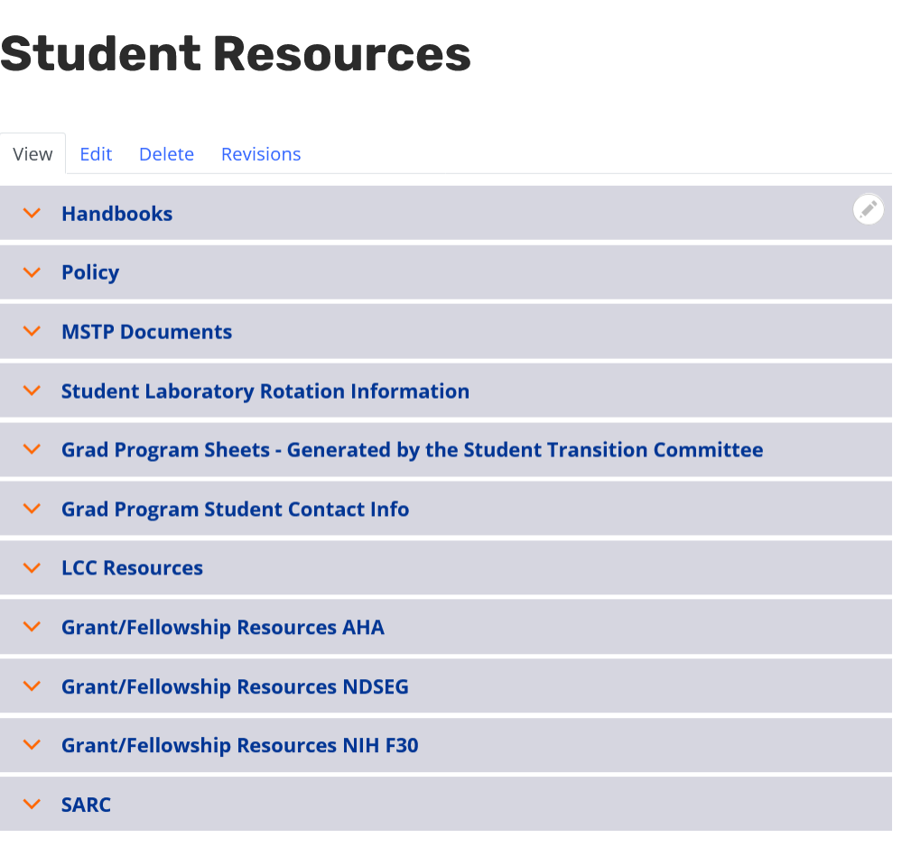
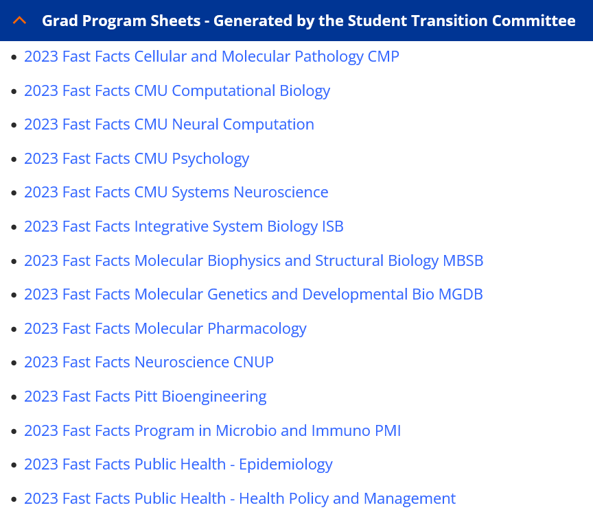
MSTP Resources
Sign into website with Pitt Passport

Slide 17


Questions?

